Slide 1
Developing the “Viking” Persona
Fixing a persona in Place and Time
HL Hjorr-yggr Hákonarson
Mka Jerry Gordon
Jerry.a.Gordon@mail.com
https://independent.academia.edu/JerryGordon

Slide 2
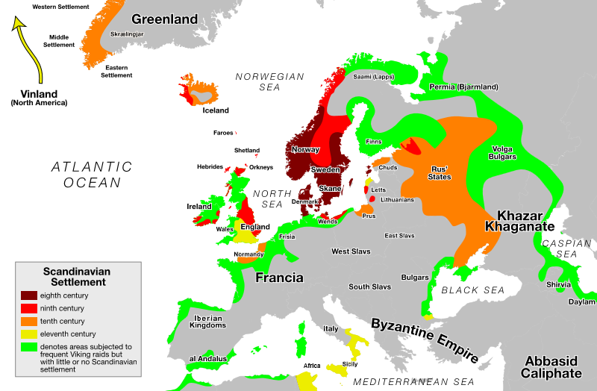
The Viking World 793-1066

Slide 3
Regional Variations
Danish Viking
Norse (Norwegian)
Iceland
Vinland
Greenland
Anglo-Danish
Normans
Lombards
Varangians
Rurikids
Dnepr Rus
Volga Rus
Lifeguards of the Basileus
Estvolk
Saami/Finnmark
Swedish Viking

Slide 4
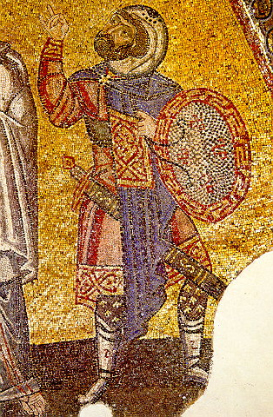
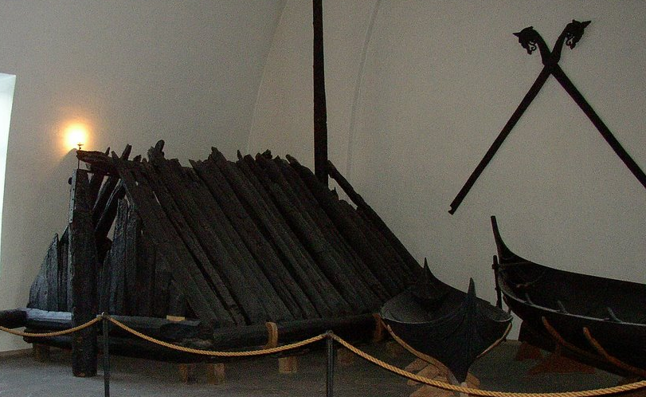
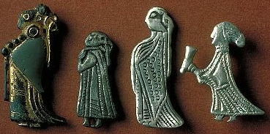
Primary Literary Sources
Icelandic “Family” Sagas and Romances
Heimskringla
Gesta Danorum
Adam of Bremen
Nestorian Chronicle
Alexiad
Liutprand of Cremona
Utrecht Psalter
Anglo Saxon Chronicle(s)
Beowulf
Ibd Fadlan Risala (travels)
Codex Runicus
Holda Grimoire
Cautionary Tales

Slide 5
Places to be From:
NORWEGIAN CITIES
Tonsberg | Pagan Norwegian capitol in Vestfold
Kaupang | Trading city in Vestfold
Nidaros | Christian Norwegian Capitol
Lofotr | Northernmost city , Halogaland
Bjorgyn | Bergen, Trading city
Oslo | Trading City in Vestfold
Trondheim/Trodelag | regions within Norway, each with a petty king /earl
Jamtaland | regions within Norway, each with a petty king /earl
Nordvegr | regions within Norway, each with a petty king /earl
Hordaland | regions within Norway, each with a petty king /earl
Frostathinglaw | regions within Norway, each with a petty king /earl
Gulathinglaw | regions within Norway, each with a petty king /earl
Gokstad | Trading City in Vestfold
ENGLISH CITIES
Jorvik | Center of Viking England (Northumbria)
Witanceaster | Knut/Svein capitol of England (Wessex)
RUSSIAN CITIES
Novgorod | St Petersburg
Gnezdovo | Largest Russian city , staging area for Kiev (now in Byelorus)
Staraya Ladoga | Large russian trading fortification (Pskov)
Kyev | Russian capitol
DANISH CITIES
Trelleborg | training fortification
Fyrkat | Pre-staging area fortification
Aarhus | baltic side trading city
Hedeby | largest trading city denmark
Ribe | oldest city denmark
Jelling | christian capitol denmark
Roskilde | pagan capitol denmark
Uppakra | Trading city in Skane (swedish part of denmark)
Lund | Largest city in Skane
Odense | Religious center of denmark (pagan and christian)
Fotoviken | Trading city in Skane (swedish part of denmark)
POLISH CITIES
Wolin | Site of the Jomsvikings
SWEDISH CITIES
Sigtuna | Swedish trading city near capitol
Gamla Uppsala | Swedish pagan capitol
Birka | Largest Swedish trading city
Gotland/Paviken | Island trading city

Slide 6
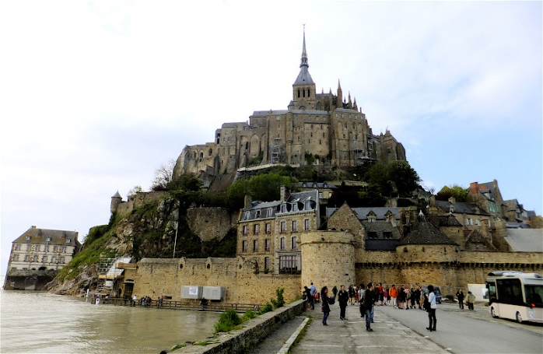
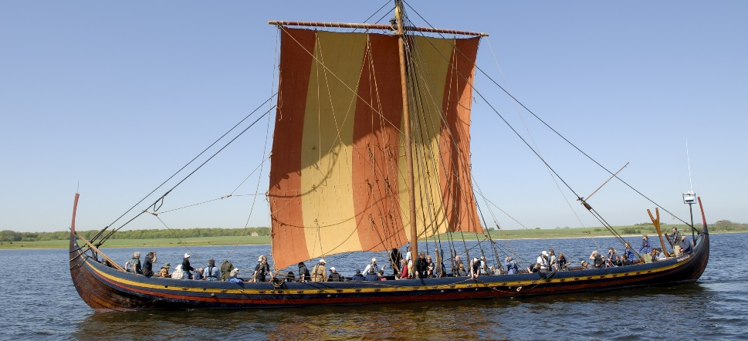
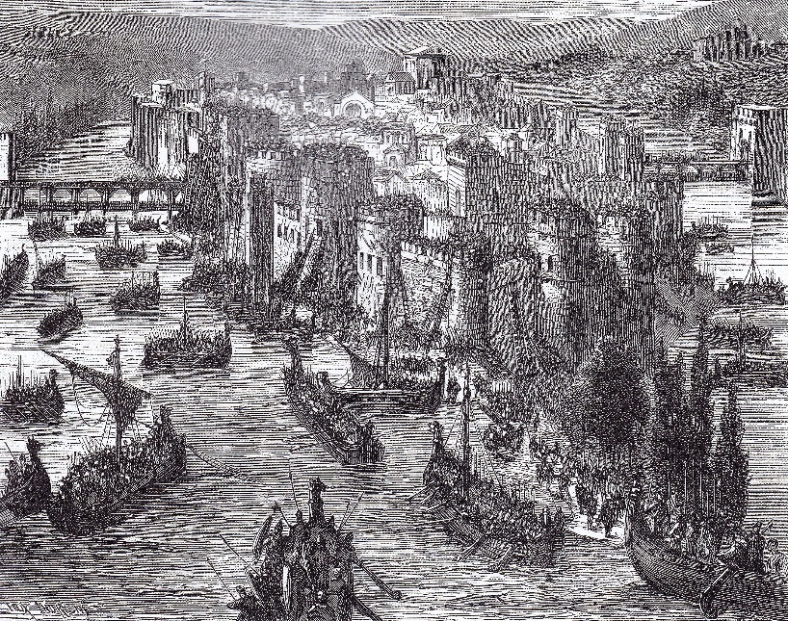
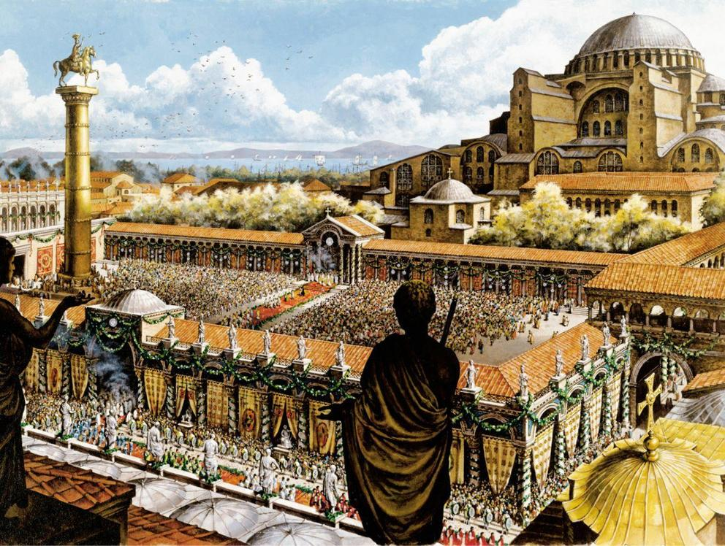
Places to Go
Strandhogg
Jorvik/Northumbria
Danelaw/Mercia East Anglia
Hibernia (Ireland)
Iceland/Shetlands/Hebrides/Man/Faroes
Greenland/Vinland
Pillars of Hercules/Sicily/Italy (Rome!)
Frankia/ Paris
Permia
Bjarmaland
Holmgard/Novgorod
Miklagard/Constantinople
Normandy/Lombardy

Slide 7
Who are You? Land Divisions and Titles
North Sea Empire (Denmark rules Norway or Vice Versa)
Kingdom (Norway-870, Denmark-980, Sweden 1016)
Land
Läg (law)
Fylki/Scir (folkrealm/Shire)
Hereð/Wapentake (Barony, “Hundred”)
Skipin
Caracute/Plōgesland
Bovate, öxgang
Könung/Dróttning
Skötkonung(under-king)
Aðalmaðr (nobleman)
Jarl (Duke, Count)
Goði/Gyða
(Chieftan/Priest)
Hofðingi
(Chieftan)
Stræmónd
(Magnate)
Hersir
(Lord Lt)
Lendrmaðr
(Baron)
Hauldr
(landholder)
Oðalbondi
(Allodial land)
Stræsmaðr
(boat captain)
Bondi
(freeman)
Sokeman, Leysing

Slide 8
What do you do? Daily Life
Reckon 8 time divisions of the day (sun up, midmorning, noon, midday, dusk, moonrise, midnight, moon set)
Saturday is washing/bathing day
Day ends at Dusk (not midnight)
Eat 2 meals a day (10ish morning meal/4ish evening meal)
Most food is boiled, most common meat is pork (slaughtered in late fall), chicken or fish
Money based on weight silver - Mörk (half a “pound”) , 8 Auror (“ounce”) , 3 Ertog, 10 Penning (1-2 gr depending on when)
Currency: 1 mark silver equivalent to 40 yds vadmal cloth and 2.5 milch cows
Pagan code of ethics in Hávamal
Danes and Russians Christian late 10th century, Iceland, Norway, Sweden (last) in early 11th
Sword Danes and Spear Danes: Jarl, Karl and Þrall
Raiding Season (summer) and farming Seasons (spring/fall), the Shieling in winter
“Long” Hundred=120
Ell (of cloth), foot, inch (tum), faðom (fathom), pund (12#), rast (“rest”, a sea mile) , dagsslátta (3/4 acre) : units of measure standardized for trade
Legal rights and obligations tied to the Ættr
Most traders were familiar with local law codes – lawyer (often the priest) was a respected profession

Slide 9
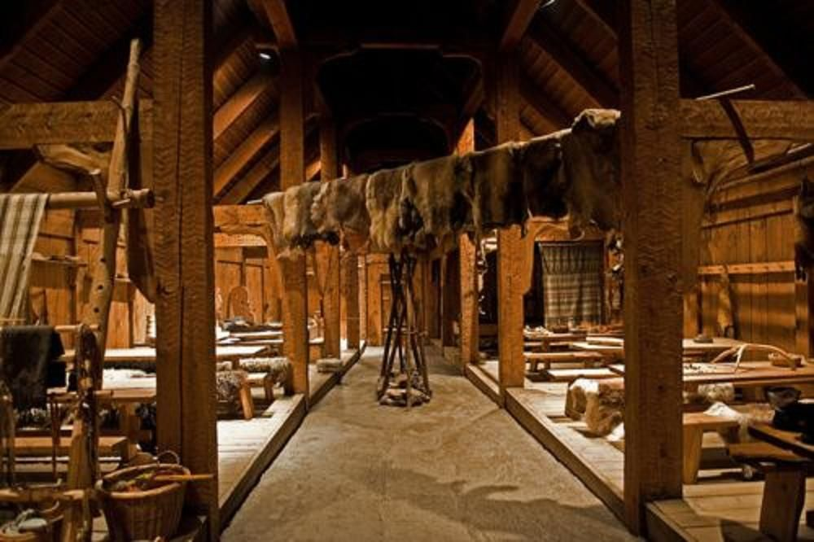
What do you do? Life in the Hall
Center of Manorial Life- far removed from town
Smallholds shared house with livestock
Lord (Húsbóndi, Drótinn) usually had separate living quarters, or enclosed chamber
Warriors (Húskarls, Drótt) slept in the hall upon flets
Feasts and celebrations
Common to Germanic tribes (Saxons, Vikings and Germans)
Kitchen (eldhús) and smithy often separate building (fire safety)

Slide 10
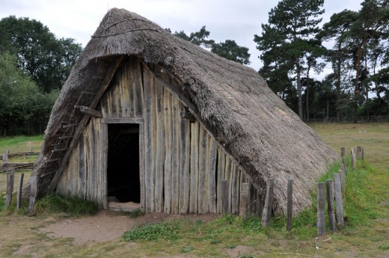
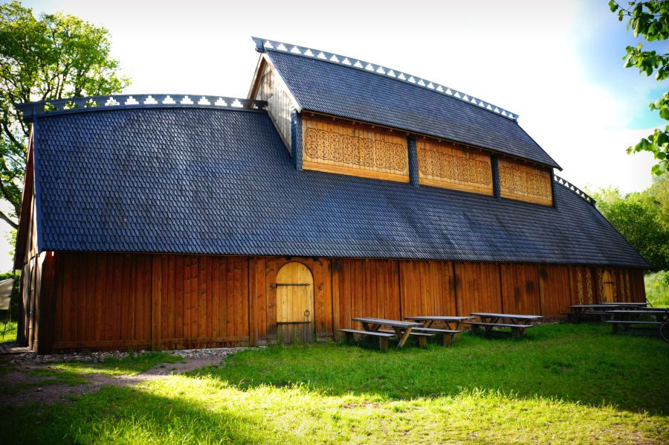
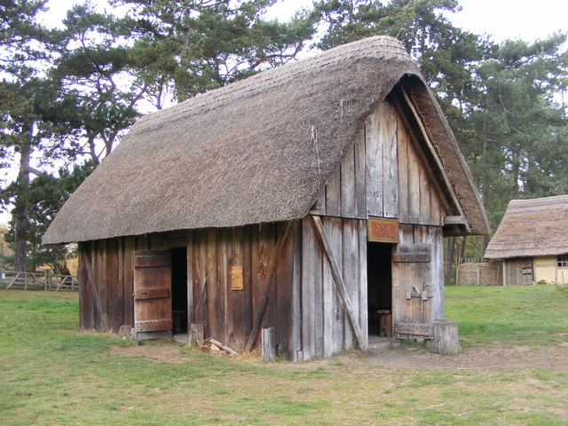
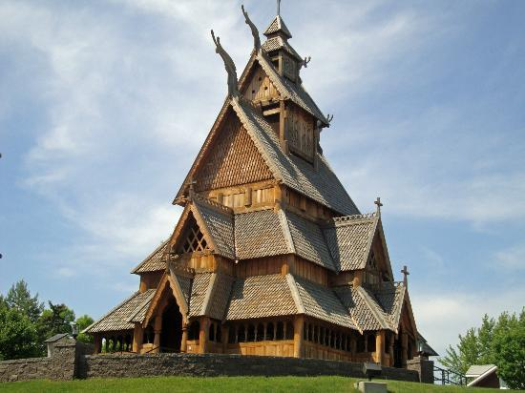
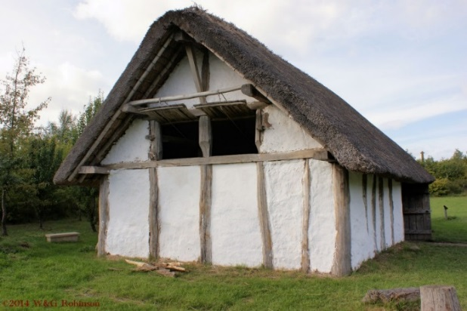
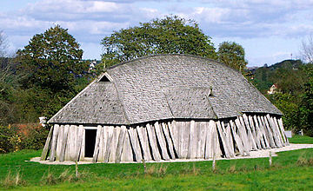
Differences in Building Construction
Queenposts, “boat roof”
Turf walls
“Sunken Featured Building”
Wattle and daub
Stave Built
Stave Church
Saxon – Beams and Stringers

Slide 11
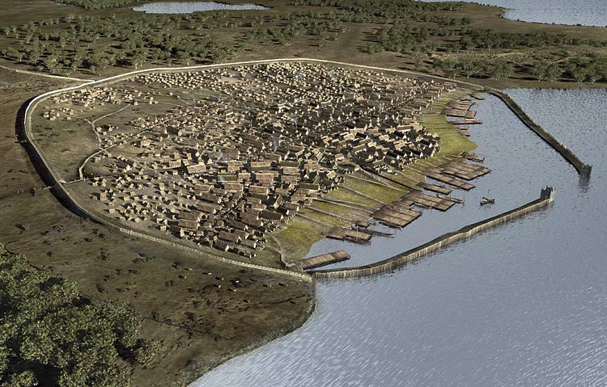
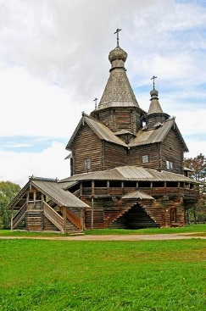
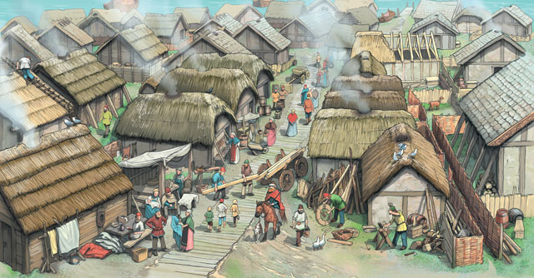
Viking Towns
Fyrkat/Trelleborg
Haiðabui
Jorvik
Holmgard (Novgorod)

Slide 12
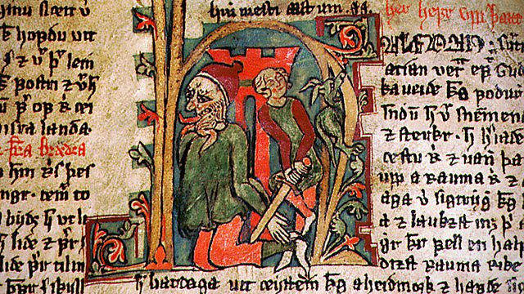
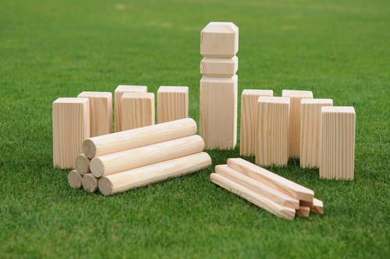
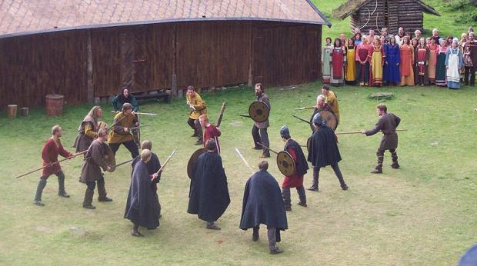
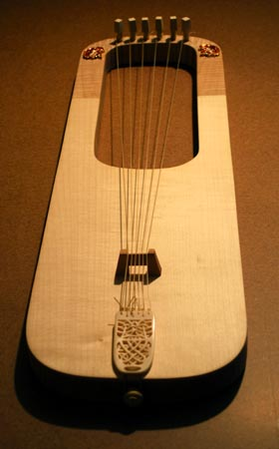
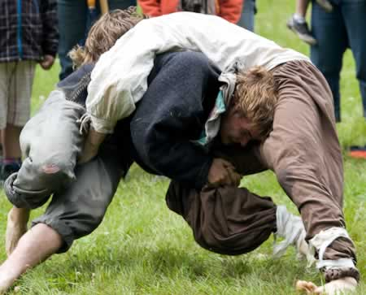
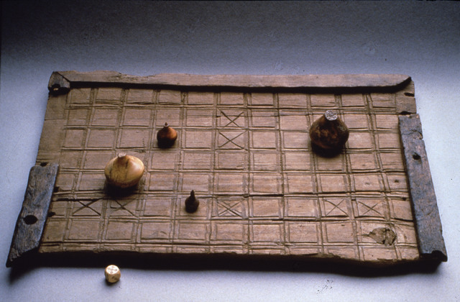
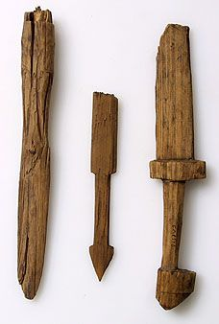
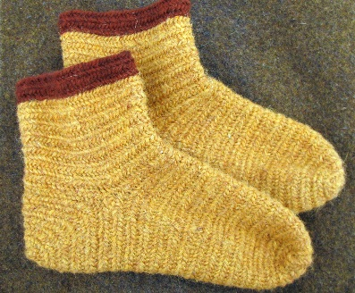
What do you do? Leisure Time
Writing:
Saga
Dróttkveit
Ljódaháttr
Galdraháttr
Dice
Kubb
Hárpa
Knattleikr
Hnefatafl
Glíma
Children’s toys
naalbinding

Slide 13
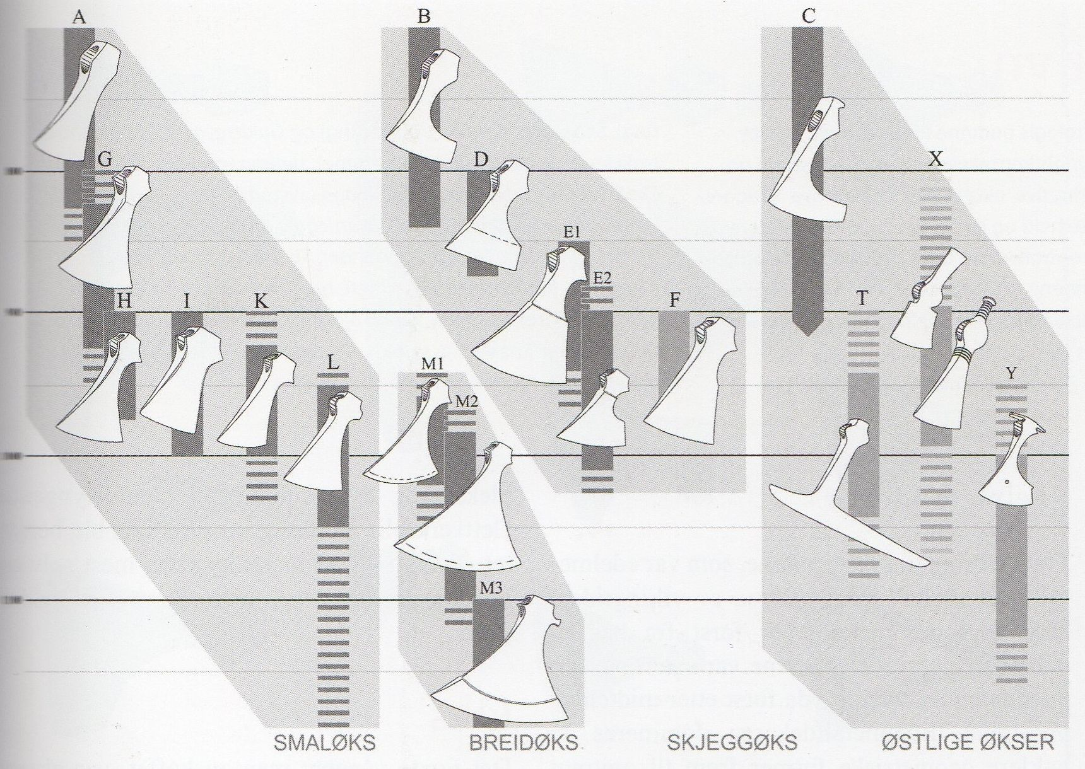
Changes to Weapons over Time

Slide 14
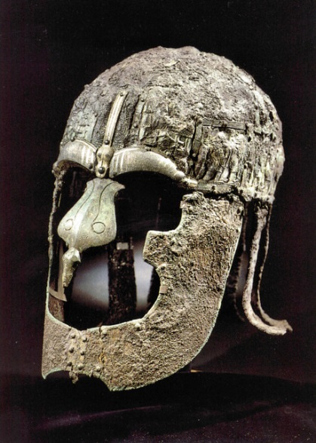
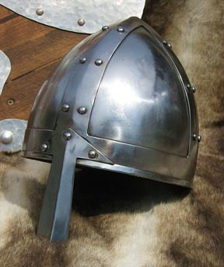
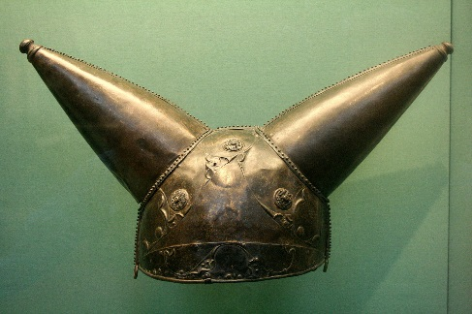
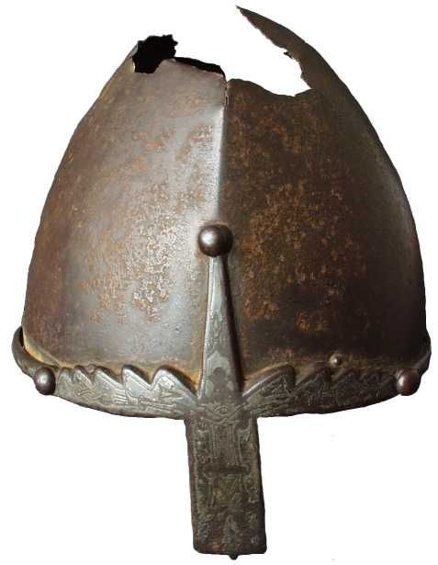
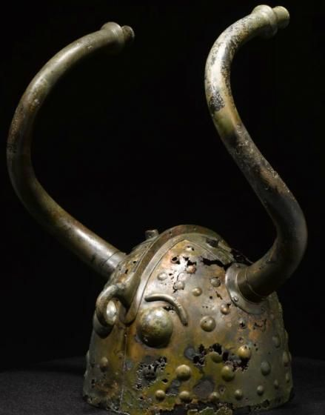
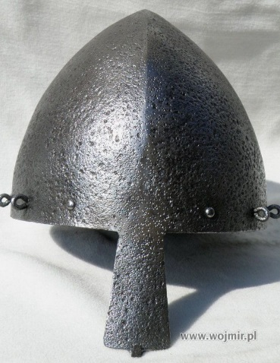
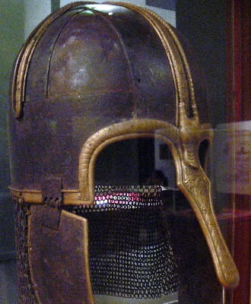
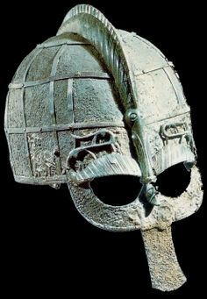
Helmets
Pre-Viking Age
Norman
Brigantes 150BC
English
Vendel/Valsgarde
Wenceslas
Gjermundbu
Cymbri 900BC
Sutton Hoo
Coppergate
Olmutz

Slide 15
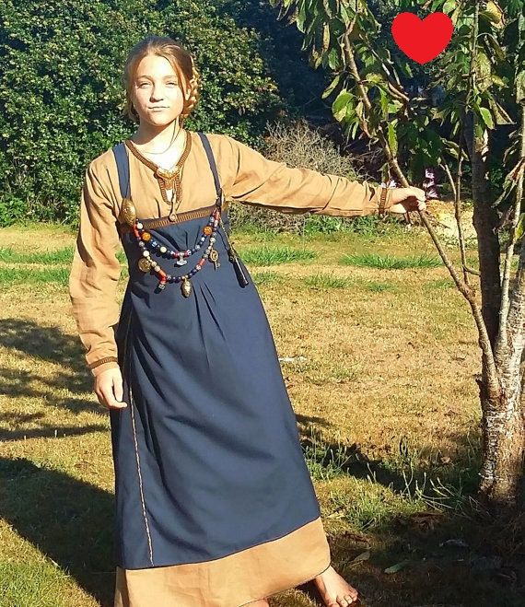
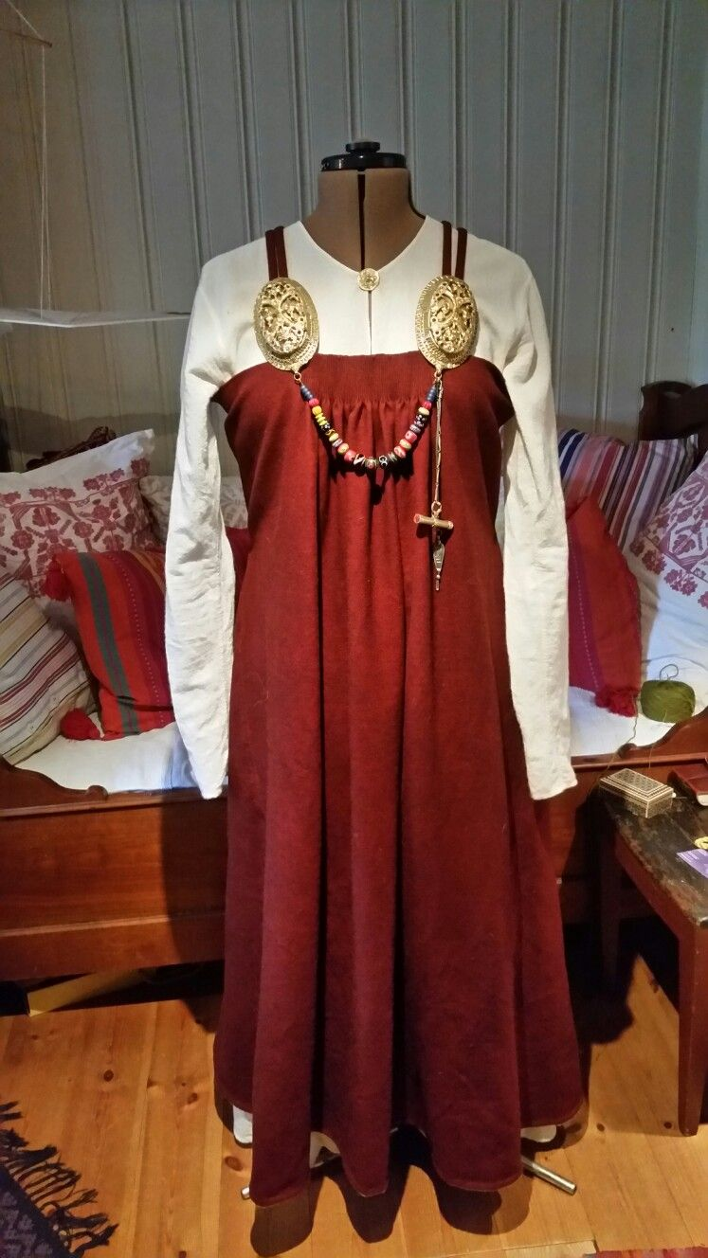
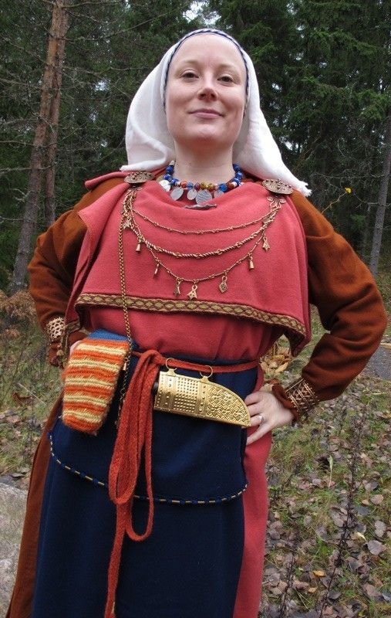
Variations in Female Dress
West
East

Slide 16
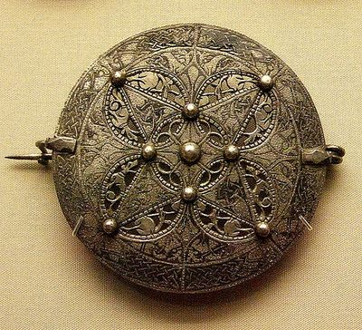
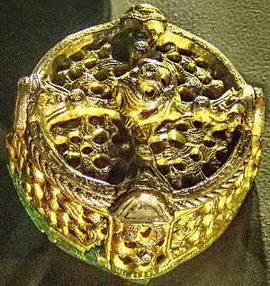
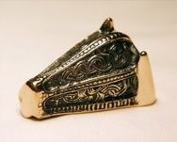
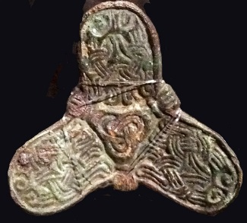
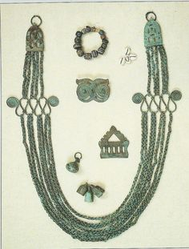
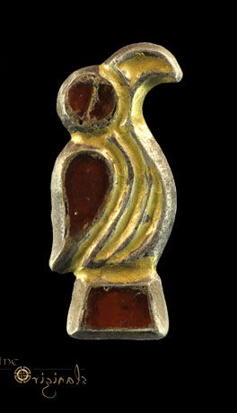
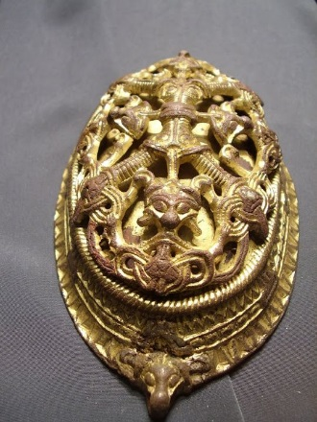
Woman’s Brooch Variations
Saxon
Early Danish
Carolingian
Gotland
Latvia/Finland
Early Norway
Late Danish/Norwegian/Icelandic
Very Late Norwegian/Icelandic
Merovingian

Slide 17
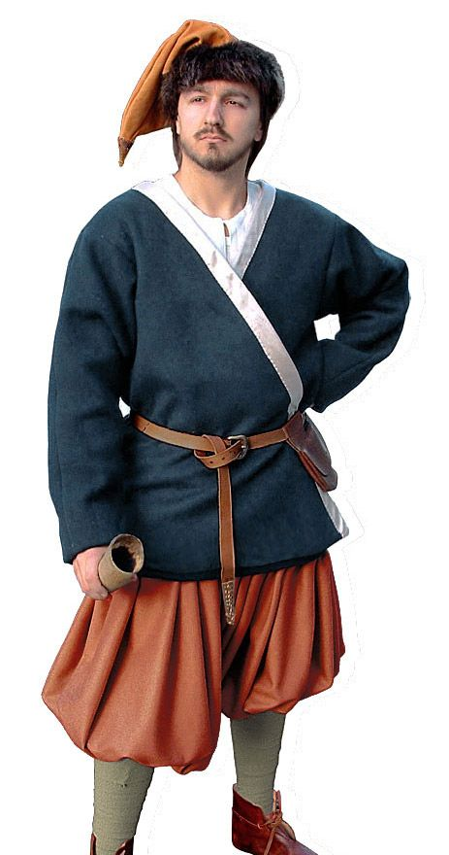
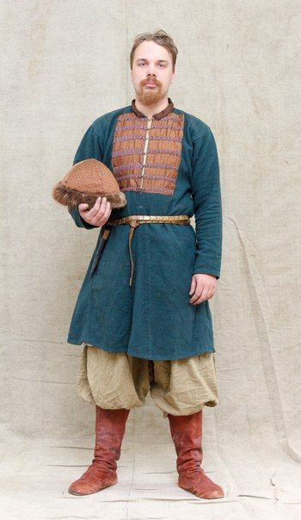
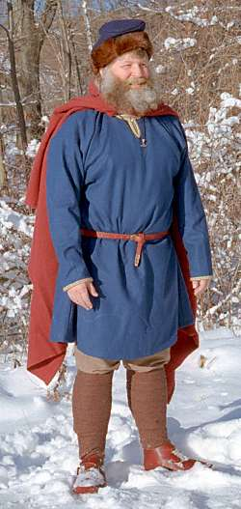
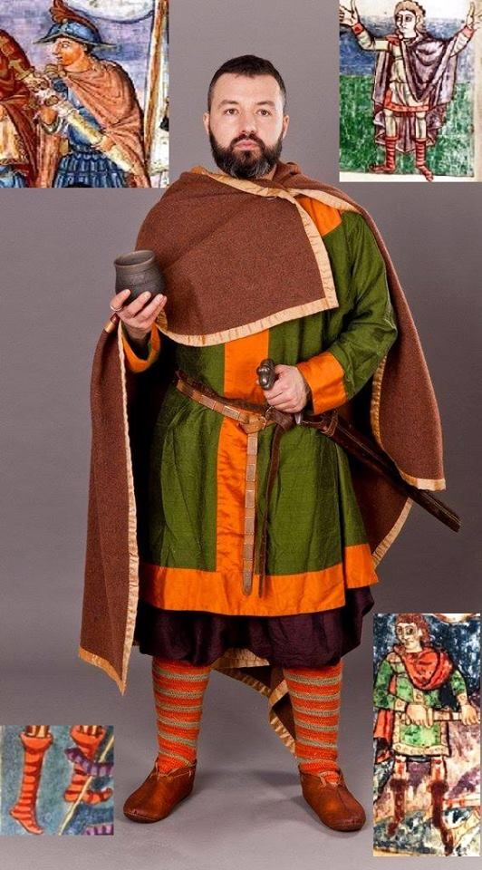
Variations in Male Dress
West
East

Slide 18
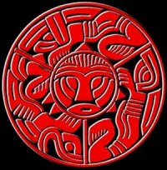
Viking Decorative Motifs
Motif: Foliate/Zoomorphic/Abstract
Massing
Infill
Symmetry
“Knotwork”
Saxon
Russian

Slide 19
Clothing Re-enactorisms and Questions
Gores vs Pleats (When/Where?)
Provenance of finds (e.g. Skjoldhamn)
Set in sleeves vs straight sleeves
Set in Gores vs Plackets
Necklines
Hats
Floppy hats
Fur hats
Pillbox hats
Dutch Caps
Phrygian Hat
Wicing Wickelbandr
Leather Clothing (Lóðbrok)
Bling (arm rings, bags and purses, knives, chatelaines)
Peplos dress - To bib or not to bib
Open vs Closed Smokkr (Hägg vs Gieir)
Aprons (Bau vs everyone else)
Linen Clothing and Linen Dyes
Embroidery (Mammen Tunic)
Metallic Trim (Silver Vs Gold vs Posiments)
Caftan patterns (Birka vs Moschevaya Balka)
Thorsberg Trousers (4th c) and (East/Early) Poofy Pants
Tube socks
Footy PJ’s
Belt Width
Scandinavian
Carolingian
Asiatic

